Slide 1

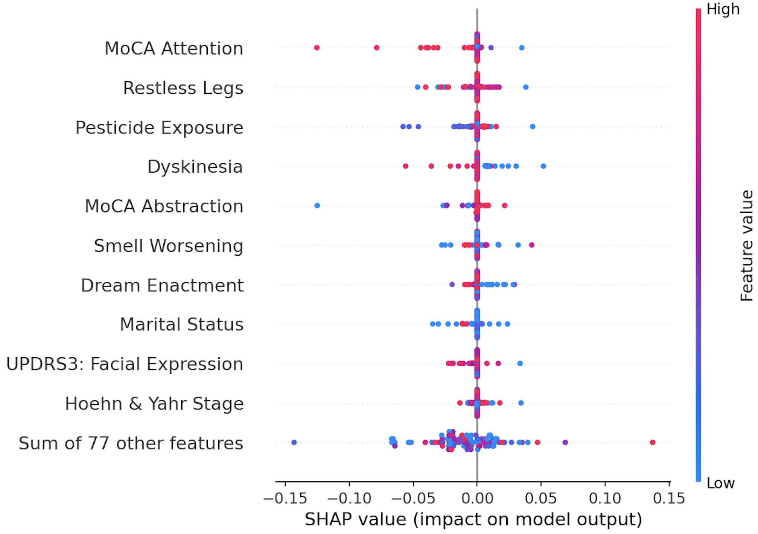
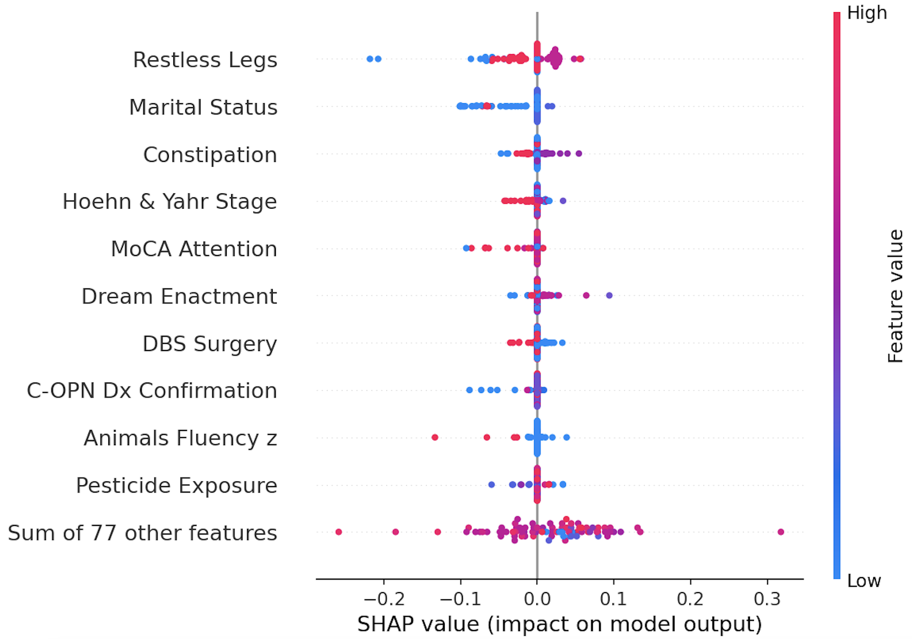
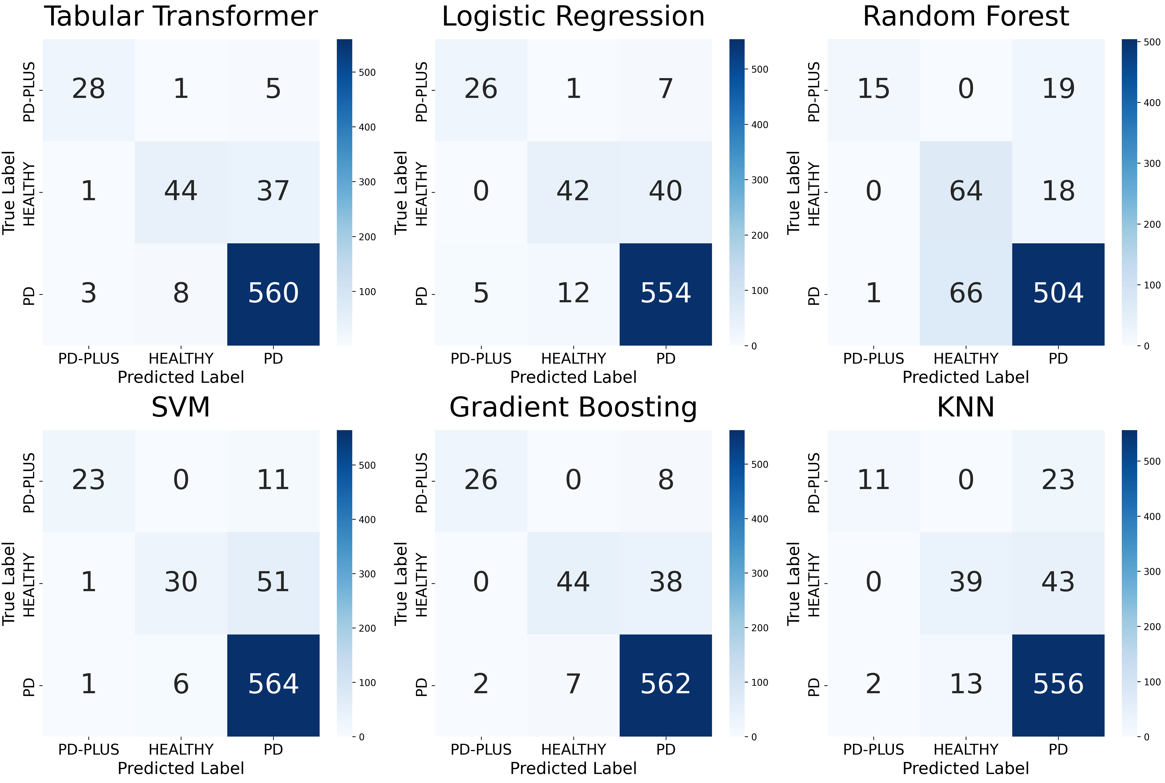
Differential Diagnosis across the Parkinsonian Spectrum
Multi-Center Validation of Classification Models for PD, PD-Plus, and Neurologically Healthy Controls
Shuxi Wu¹, Vivienne Wang¹, Jianyue Bai¹, Javier Mencia Ledo¹
¹Dalla Lana School of Public Health, Biostatistics Division
Overview
Results
Parkinson's disease (PD) and atypical parkinsonism (PD-plus) are clinically difficult to distinguish. Using C-OPN data (n = 3,433), we developed and compared six classification models which includes a Tabular Transformer and five traditional machine learning models. We use them to differentiate PD, PD-plus and healthy controls using clinical and neuropsychological features.
Demographic and Clinical Characteristics by Diagnosis Group
2. SHAP Analysis: Risk Drivers of Predictions
 | Overall | PD | Healthy control | PD-Plus
Sample Size (n) | 3541 | 2852 | 410 | 171
Current Age | 66.20 (10.04) | 66.59 (9.59) | 62.54 (12.22) | 66.64 (11.71)
Number of Males | 1804 (50.9%) | 1612 (56.5%) | 181 (44.1%) | 78 (45.6%)
Disease Duration | 9.64 (6.01) | 9.83 (5.98) | --- | 6.05 (5.50)
MoCA Score | 26.70 (2.71) | 26.58 (2.53) | 27.78 (3.15) | 22.00 (nan)
BDI Score | 9.65 (7.53) | 9.66 (7.35) | 6.24 (5.93) | 16.76 (10.45)
MBI Score | 0 .94 (4.22) | 0.93 (4.09) | 0.33 (2.01) | 3.24 ( 8.62)
EHI Score | 0.71 (0.46) | 0.72 (0.44) | 0.66 (0.56) | 0.72 (0.50)
Loss of Smell | 2537 (72.6%) | 2090 (73.3%) | 240 (58.5%) | 101 (59.1%)
Right Hand Dominant | 1888 (53.3%) | 1765 (61.9%) | 20 (4.9%) | 102 (59.6%)
Regular Exercise | 1795 (50.7%) | 1555 (54.5%) | 162 (39.5%) | 72 42.1%)
Coffee Drinker | 1735 (49.0%) | 1480 (51.9%) | 160 (39.0%) | 90 (52.6%)
SHAP quantifies each feature's contribution to a prediction by computing its marginal impact relative to a baseline expected output.
Hoehn & Yahr Stage, Restless Legs, and MoCA Attention were the most influential discriminators, with motor severity and non-motor symptoms driving class separation.
Background
Beeswarm Plot for PD-Plus
PD is the 2nd most common neurodegenerative disorder, affecting 110,000+ Canadians.
PD-PLus (PSP,MSA, CSB, DLB) shares motor features with PD but progresses faster and responds poorly to levodopa
No Reliable Clinical tool existes to distinguish PD and PD-Plus at scale.
Objectives
Evaluate and compare the efficacy of various models in differentiating PD, PD-Plus, and neurologically healthy controls.
Interpret individual predictions and identify key risk drivers through SHAP analysis.
Methods
Variables:
Demographics: Age at visit, Gender
Clinical: disease duration, age at diagnosis, current symptoms, symptom laterality, loss of smell, dominant hand, exercise, coffee intake
Behavioural: MBI-C, BDI-II, MoCA, EHI score
Preprocessing:
Median imputation for continuous variables; constant missing imputation for categorical variables to handle high missingness rates.
StandardScaler for continuous variables; one-hot encoding for categorical variables
SMOTE applied to address class imbalance in training.
6 Candidate Models:
Tabular Transformer, Logistic Regression, Random Forest, SVM, Gradient Boosting, K Nearest Neighbors (KNN) models
Model Selection:
3-fold CV optimized on weighted F1-scores with 20% holdout validation set
Hyperparameter tuning via GridSearchCV with per-class threshold optimization
Final model selected based on Accuracy, Macro AUC, Macro F1, and Kappa
Model Diagonosis:
Direct three-class classification: PD, PD-plus, and Healthy Controls
Tabular Transformer and five traditional ML models applied independently
All models evaluated on the same held-out test set (20%)
1. Healthy Controls vs Parkinson’s
Beeswarm Plot for PD
Model | Accuracy | AUC | F1 | Precision | Recall | Kappa
Tabular Transformer | 0.923 | 0.957 | 0.829 | 0.875 | 0.795 | 0.710
Logistic Regression | 0.905 | 0.936 | 0.786 | 0.841 | 0.749 | 0.638
Random Forest | 0.849 | 0.936 | 0.703 | 0.787 | 0.701 | 0.529
SVM | 0.897 | 0.928 | 0.734 | 0.855 | 0.676 | 0.566
Gradient Boosting | 0.920 | 0.962 | 0.818 | 0.905 | 0.762 | 0.684
KNN | 0.882 | 0.865 | 0.661 | 0.830 | 0.591 | 0.504
.
Conclusion
The Tabular Transformer achieved the strongest overall performance (Accuracy = 0.923, AUC = 0.957, F1 = 0.829) which outperformed all five traditional ML models in three-class classification.
PD-plus remained the most challenging class to classify across all models, driven by severe class imbalance (4.6% of sample) and clinical overlap with PD.
SHAP analysis revealed distinct predictor profiles: cognitive features (MoCA Attention) and non-motor symptoms dominate AP classification, while gastrointestinal and sleep-related features are more predictive of PD.
Future work should incorporate larger PD-plus cohorts and external site-based validation to improve generalizability of the classification model.

